Slide 1
Lecture 4
Linking and ELF
(A small digression)

Slide 2

Learning Objectives
Learn about the linking and loader process
What are they and why they are designed in that way
Learn the Executable and Linking Format (ELF)

Slide 3
The compilation flow
Header files (.h)
Source files (.c, .cc)
Compiler
And Assembler
Object files (.o)
Static libraries (.a)
Dynamic libraries (.dll)
(Separate compilation)
Linker
Executable
Loader
In-memory image

Slide 4
Main functions
High level programming languages are good for human productivity
But they are not what the machine understands
Compilers: translate code written in high-level programming languages to assembly code of the target machine’s ISA
Assemblers: translate human readable assembly code to binary object files
Linker: combines multiple object files and library modules into a single executable
Loader: reads the executable and together with dynamic libraries, constructs a memory image of the application

Slide 5
Important design considerations
Separate compilation
Allows for a better organization of the source code
Also facilitates sharing during code writing
Only need to recompile changed code
External linkages
Modern applications are built on layers of libraries

Slide 6
Executable files
Information needs to be conveyed to the OS
The OS expects executable files to have a specific format
Header info
Code locations
Data locations
Code & data
Symbol Table
List of names of things defined in your program and where they are defined
List of names of things defined elsewhere that are used by your program, and where they are used.

Slide 7
Example – definition and use
#include <stdio.h>
int main () {
printf (“hello, world\n”)
}
Symbol defined in your program and used elsewhere
main
Symbol defined elsewhere and used by your program
printf

Slide 8
A two-step operation
Linking: Combining a set of programs, including library routines, to create a loadable image
Resolving symbols defined within the set
Listing symbols needing to be resolved by loader
Loading: Starting from the loadable file, copy in dynamic libraries and construct the memory image in a new process

Slide 9
Key activities involved
Relocation: assigning load addresses to various parts of a program and adjusting the code and data in the program to reflect such assignments
Symbol resolution: maps symbols into the actual location in a memory image
Loading: constructing a memory image in a OS process from the executable on secondary storage

Slide 10
Executable and Linking File Format
(ELF)

Slide 11
ELF
Support for cross-compilation, dynamic linking, initializer/finalizer (e.g., the constructor and destructor in C++) and other advanced system features
ELF has been adopted by FreeBSD and Linux as the current standard
ELF32 for 32-bit binaries and ELF64 for 64-bit binaries
Almost identical except for length of data

Slide 12
ELF File Types
Relocatable (object files)
Created by compilers or assemblers. Need to be processed by the linker before running. Addresses assumed to start at zero.
Executable
All relocation done and all symbol resolved except for shared library symbols that must be resolved at run time
Shared object
Shared library containing both symbol information for the linker and directly runnable code
Core file
For core dumps

Slide 13
ELF Structure
Compilers, assemblers, and linkers treat the file as a set of logical sections described by a section header table.
The system loader treats the file as a set of segments described by a program header table.

Slide 14
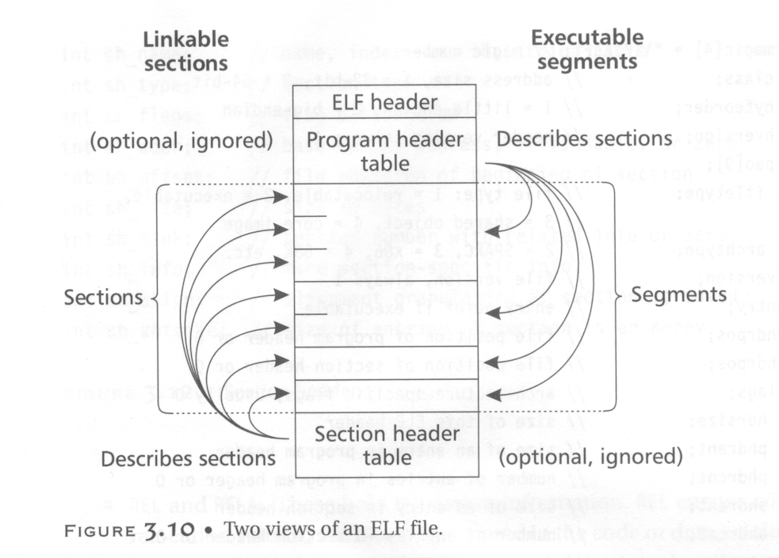
segments

Slide 15
ELF Structure
A single segment usually consist of several sections. E.g., a loadable read-only segment could contain sections for executable code, read-only data, and symbols for the dynamic linker.
Relocatable files have section header tables. Executable files have program header tables. Shared object files have both.
Sections are intended for further processing by a linker, while the segments are intended to be mapped into memory.
See /usr/include/elf.h

Slide 16
ELF Header
The ELF header is always at offset zero of the file.
The program header table and the section header table’s offset in the file are defined in the ELF header.
Use fseek() to find.
The header is decodable even on machines with a different byte order from the file’s target architecture.
After reading class and byteorder fields, the rest fields in the ELF header can be decoded.
ELF supports two different address sizes:
32 bits
64 bits

Slide 17
ELF Program Header (32 bits)
typedef struct
{
unsigned char e_ident[EI_NIDENT]; /* Magic number and other info */
Elf32_Half e_type; /* Object file type */
Elf32_Half e_machine; /* Architecture */
Elf32_Word e_version; /* Object file version */
Elf32_Addr e_entry; /* Entry point virtual address */
Elf32_Off e_phoff; /* Program header table file offset */
Elf32_Off e_shoff; /* Section header table file offset */
Elf32_Word e_flags; /* Processor-specific flags */
Elf32_Half e_ehsize; /* ELF header size in bytes */
Elf32_Half e_phentsize; /* Program header table entry size */
Elf32_Half e_phnum; /* Program header table entry count */
Elf32_Half e_shentsize; /* Section header table entry size */
Elf32_Half e_shnum; /* Section header table entry count */
Elf32_Half e_shstrndx; /* Section header string table index */
} Elf32_Ehdr;
4-byte magic number is “0x7F” followed by the string “ELF”.

Slide 18
Relocatable Files
A relocatable or shared object file is a collection of sections.
Each section contains a single type of information, such as program code, read-only data,or read/write data, relocation entries, or symbols.
Every symbol’s address is defined relative to a section.
Therefore, a procedure’s entry point is relative to the program code section that contains that procedure’s code.

Slide 19
Section Header
typedef struct
{
Elf32_Word sh_name; /* Section name (string tbl index) */
Elf32_Word sh_type; /* Section type */
Elf32_Word sh_flags; /* Section flags */
Elf32_Addr sh_addr; /* Section virtual addr at execution */
Elf32_Off sh_offset; /* Section file offset */
Elf32_Word sh_size; /* Section size in bytes */
Elf32_Word sh_link; /* Link to another section */
Elf32_Word sh_info; /* Additional section information */
Elf32_Word sh_addralign; /* Section alignment */
Elf32_Word sh_entsize; /* Entry size if section holds table */
} Elf32_Shdr;

Slide 20
Types in Section Header (sh_type)
PROGBITS: This holds program contents including code, data, and debugger information.
NOBITS: Like PROGBITS. However, it occupies no space.
SYMTAB and DYNSYM: These hold symbol table.
STRTAB: This is a string table.
REL and RELA: These hold relocation information.
DYNAMIC and HASH: This holds information related to dynamic linking.

Slide 21
Flags in Section Header (sh_flags)
WRITE: This section contains data that is writable during process execution.
ALLOC: This section occupies memory during process execution.
EXECINSTR: This section contains executable machine instructions.

Slide 22
Sections
.text:
This section holds executable instructions of a program.
Type: PROGBITS
Flags: ALLOC + EXECINSTR
.data:
This section holds initialized data that contributes to the program’s image.
Type: PROGBITS
Flags: ALLOC + WRITE

Slide 23
Sections
.rodata:
This section holds read-only data.
Type: PROGBITS
Flags: ALLOC
.bss :
This section holds data with no initial values. The system will initialize the data to zero when the program begins to run.
Type: NOBITS
Flags: ALLOC + WRITE

Slide 24
Sections
.rel.text, .rel.data, and .rel.rodata:
These contain the relocation information for the corresponding text or data sections.
Type: REL
Flags: ALLOC is turned on if the file has a loadable segment that includes relocation.
.symtab:
This section hold a symbol table.
.strtab:
This section holds strings.

Slide 25
Sections
.init:
This section holds executable instructions that contribute to the process initialization code.
Type: PROGBITS
Flags: ALLOC + EXECINSTR
.fini:
This section hold executable instructions that contribute to the process termination code.
Type: PROGBITS
Flags: ALLOC + EXECINSTR
Programming language specific.
C does not need these two sections. However, C++ needs them.

Slide 26
Sections
.interp:
This section holds the pathname of a program interpreter.
Type: ALLOC
Flags: PROGBITS
If this section is present, rather than running the program directly, the system runs the interpreter and passes it the ELF file as an argument.
This facility runs non-text programs.
In practice, this is used to run the run-time dynamic linker to load the program and to link in any required shared libraries.
Variants of “ld.so” – the loader.

Slide 27
Sections
.debug:
This section holds symbolic debugging information.
Type: PROGBIT
.line:
This section holds line number information for symbolic debugging, which describes the correspondence between the program source and the machine code (ever used gdb?)
Type: PROGBIT
.comment
This section may store extra information.

Slide 28
Sections
.got:
This section holds the global offset table.
Crucial for shared library.
Type: PROGBIT
.plt:
This section holds the procedure linkage table.
Type: PROGBIT
.note:
This section contains some extra information.

Slide 29
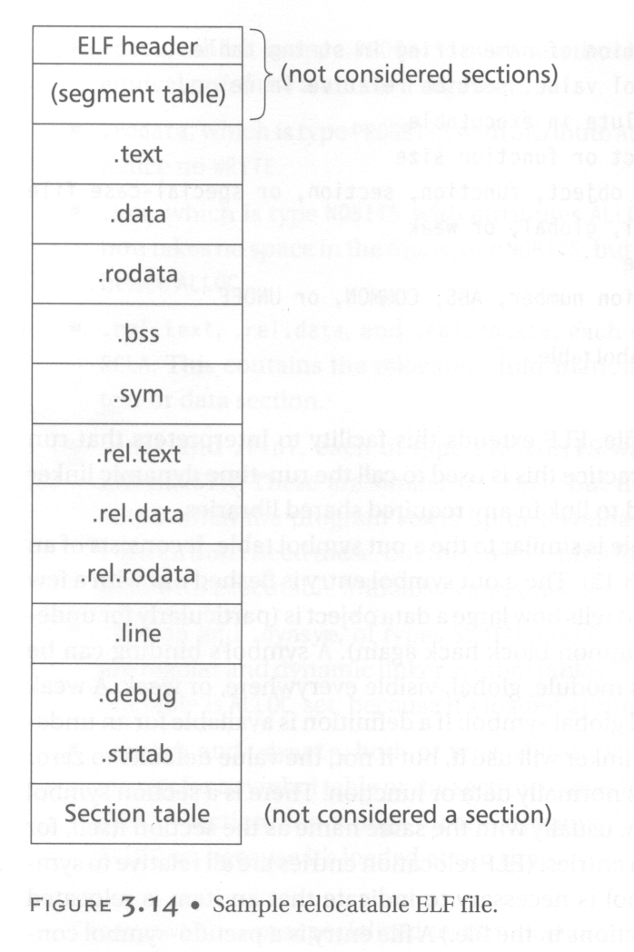
A typical relocatable file

Slide 30
String Table
String table sections hold null-terminated character sequences, commonly called strings.
The object file uses these strings to represent symbol and section names.
We use an index into the string table section to reference a string.
Separating symbol names from symbol tables frees us from any length limitation.

Slide 31
Symbol Table
An array that holds information needed to locate and relocate a program’s symbolic definition and references.
A symbol table index is a subscript into this array.

Slide 32
Symbol Table
typedef struct
{
Elf32_Word st_name; /* Symbol name (string tbl index) */
Elf32_Addr st_value; /* Symbol value */
Elf32_Word st_size; /* Symbol size */
unsigned char st_info; /* Symbol type and binding */
unsigned char st_other; /* Symbol visibility */
Elf32_Section st_shndx; /* Section index */
} Elf32_Sym;
The section relative in which the symbol
is defined. (e.g., the function entry points
are defined relative to .text)

Slide 33
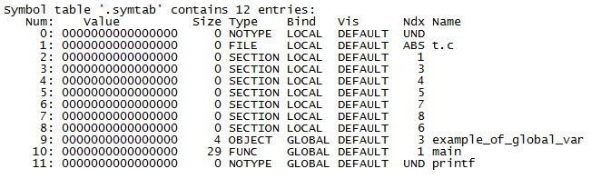
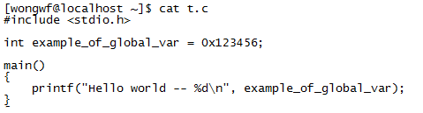
An example of a symbol table

Slide 34
.symtab vs .dynsym
Sharable objects (libraries) and dynamic executables has two distinct symbol tables
.dynsym ⊆ .symtab
.symtab is the full symbol table
Needed at static link time
Not all info needed at runtime hence not allocated in process memory
.dynsym is the subset of .symtab needed at runtime
For runtime linking, loading and debugging

Slide 35
Symbol Lookup
Two ways to lookup:
If you know the index, then use index the symbol table
If you only have a name, then you need the .hash or .gnu.hash sections
If symbol_table[hash_table[hash(symbol_name)]] == symbol_name then a hit (ok, more complicated than this…)

Slide 36
The four .gnu.hash sections
Header: four 32-bit words
nbuckets: number of hash buckets
symndx: number of symbols of the dynamic symbol table that has been hashed
.dynsym may still contain other symbols not hashed
maskwords: number of words in the Bloom filter section
shift2 – a shift count used in the Bloom filter
Bloom Filter
Hash Buckets
Hash Values

Slide 37
Bloom Filters
A Bloom filter probabilistically tests whether an element is a member of a set.
False positive matches are possible, but false negatives are not.
A query returns either “possibly in set” or “definitely not in set”.
Elements can be added to the set, but not removed.
The more elements that are added to the set, the larger the probability of false positives.
- Wikipedia

Slide 38
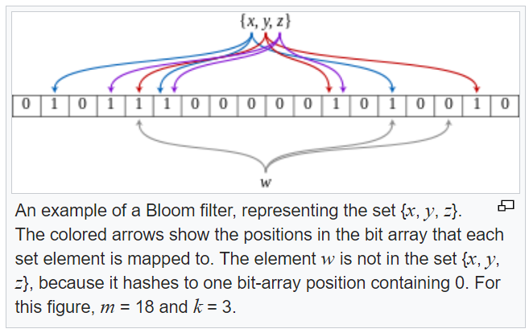
Bloom Filter Example
Wikipedia

Slide 39
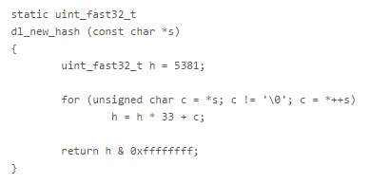
GNU Hash
Uses k=2 Bloom filter
H1 = dl_new_hash(symbol_name)
H2 = H1 >> shift2
N = ((H1 / C) % maskwords)
BITMASK = (1 << (H1 % C)) | (1 << (H2 % C))
bloom[N] |= BITMASK
Test: (bloom[N] & BITMASK) == BITMASK
C = size of one mask word in bits

Slide 40
Hash buckets
An array where each entry N is the lowest index into the dynamic symbol table for which:
(dl_new_hash(symname) % nbuckets) == N
dynsym[buckets[N]] is the first symbol in the hash chain that will contain the desired symbol if it exists.

Slide 41
High level walkthrough - 1
Compute H1, a 32 or 64 bit (depending on the ELF type) hash value for the symbol name (a C string)
Use part of H1 to be another hash H2
Use H1 to compute N, an index into the Bloom array
Create a BITMASK – where there is two 1’s at (H1 % C) and (H2 % C)
Test if bloom[N] has two 1’s at BITMASK positions
If false, we can confirm symbol not found

Slide 42
Hash values
Last of the 4 parts of .gnu.hash
One entry for every (hashed) symbol of .dynsym.
The top 31 bits of each entry contains the top 31 bits of the corresponding symbol's hash value.
The least significant bit is used as a stopper bit.
It is set to 1 when a symbol is the last symbol in a given hash chain.

Slide 43
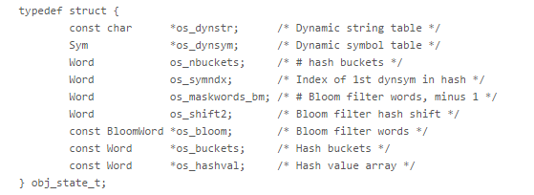
Code walkthrough
Assume…
https://blogs.oracle.com/ali/entry/gnu_hash_elf_sections

Slide 44
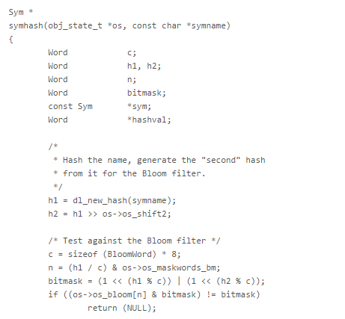
Code walkthrough
If Bloom test fails, for sure not found.

Slide 45
High level walkthrough - 2
If it is true, we still need to check further coz Bloom filters can give false positives
Dynamic symbol table organized by hash buckets
Compute n – index into the hash bucket

Slide 46
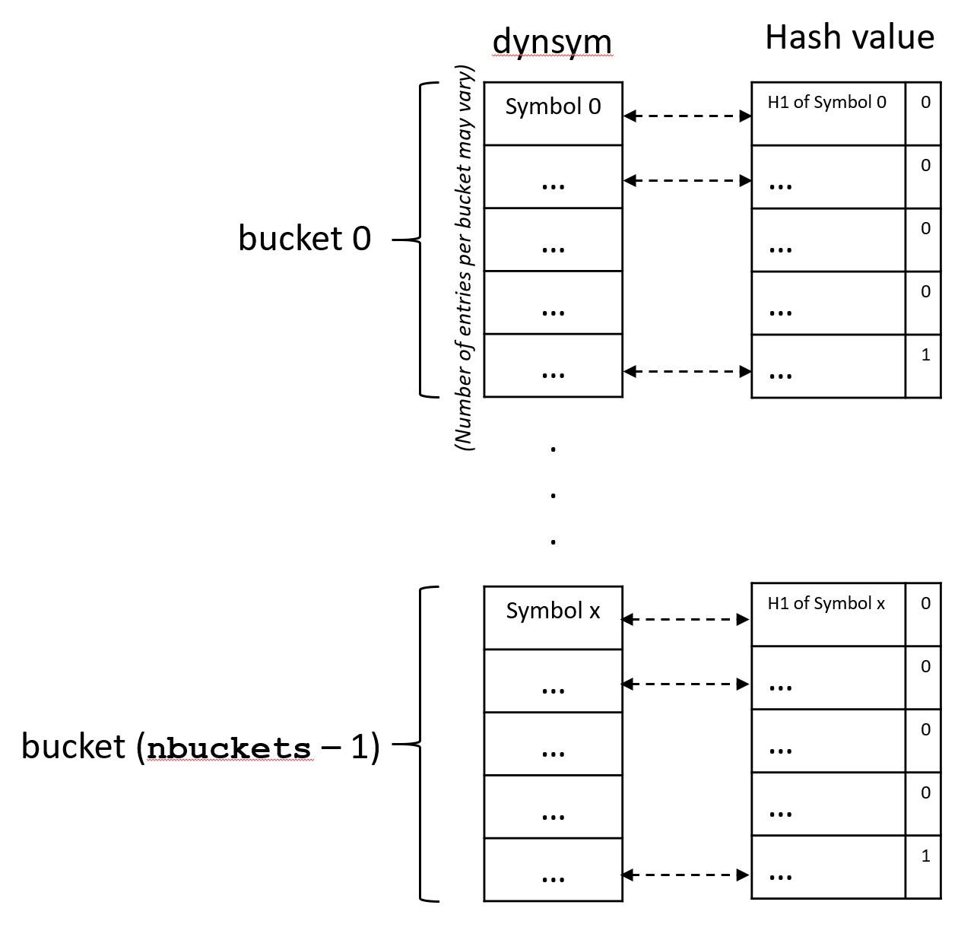
Dynamic symbol table hash buckets
A single array
Scan list of hash value
If match found, compare symbol name string
End of one list

Slide 47
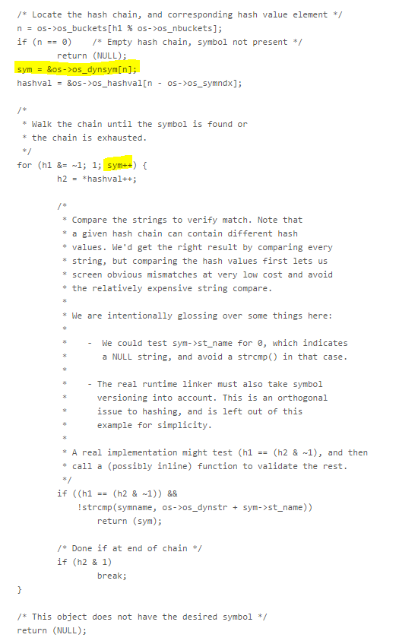
Code walkthrough

Slide 48
A small digression: Name Mangling
Names in the symbol tables are often not the same names used in the source code
Three reasons:
Avoid name collision
Name overloading
Type checking
Unfortunately, no standard – every compiler does its own thing
GNU C++ example - Wikipedia

Slide 49
Relocation Table
Relocation is the process of connecting symbolic references with symbolic definitions.
Relocatable files must have information that describes how to modify their section contents.
A relocation table consists on many relocation structures.
Essentially “determine the value of X, and put that value into the binary at offset Y”

Slide 50
Relocation Structure
r_offset:
This field gives the location at which to apply the relocation.
For a relocatable file, the value is the byte offset from the beginning of the section to the storage unit affect by the relocation.
For an executable file and shared object, the value is the virtual address of the storage unit affected by the relocation.

Slide 51
Relocation Structure
r_info:
This field gives both the symbol table index with respect to which the relocation must be made and the type of relocation to apply.
r_addend:
This field specifies a constant addend used to compute the value to be stored into the relocation field.

Slide 52

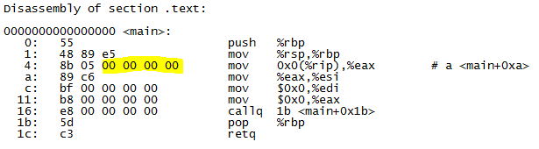
Example
“In the final binary, patch the value at offset 0x6 in this object file with the address of symbol example_of_a_global_var”

Slide 53
Executable Files
An executable file usually has only a few segments. E.g.,
A read-only one for the code.
A read-only one for read-only data.
A read/write one for read/write data.
All of the loadable sections are packed into the appropriate segments so that the system can map the file with just one or two operations.
E.g., If there is a .init and .fini sections, those sections will be put into the read-only text segment.

Slide 54
Program Header
typedef struct
{
Elf32_Word p_type; /* Segment type */
Elf32_Off p_offset; /* Segment file offset */
Elf32_Addr p_vaddr; /* Segment virtual address */
Elf32_Addr p_paddr; /* Segment physical address */
Elf32_Word p_filesz; /* Segment size in file */
Elf32_Word p_memsz; /* Segment size in memory */
Elf32_Word p_flags; /* Segment flags */
Elf32_Word p_align; /* Segment alignment */
} Elf32_Phdr;

Slide 55
The Types in Program Header
PT_LOAD: This segment is a loadable segment.
PT_DYNAMIC: This array element specifies dynamic linking information.
PT_INTERP: This element specified the location and size of a null-terminated path name to invoke as an interpreter.

Slide 56
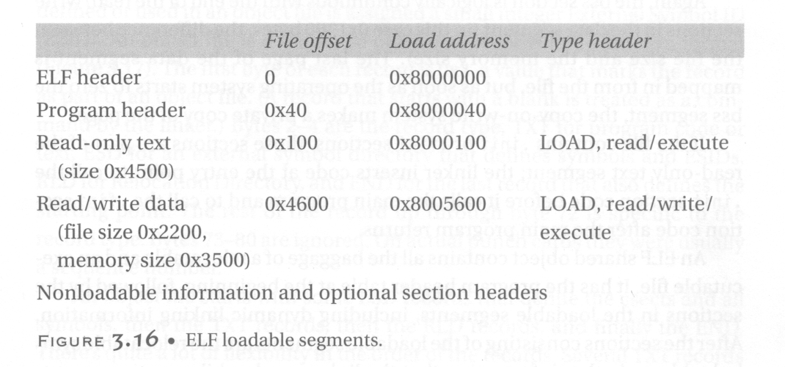
Executable File Example

Slide 57
An Example C Program

Slide 58

ELF Header Information

Slide 59
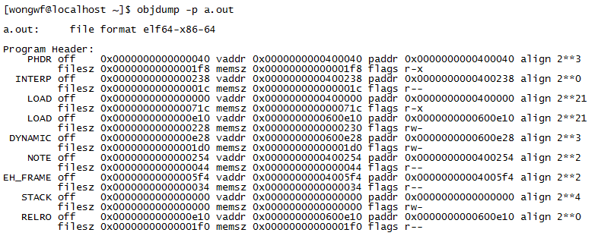
Program Header

Slide 60
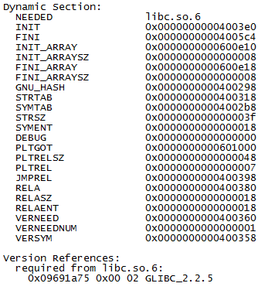
Dynamic Section
Need to link this shared library
for printf()

Slide 61
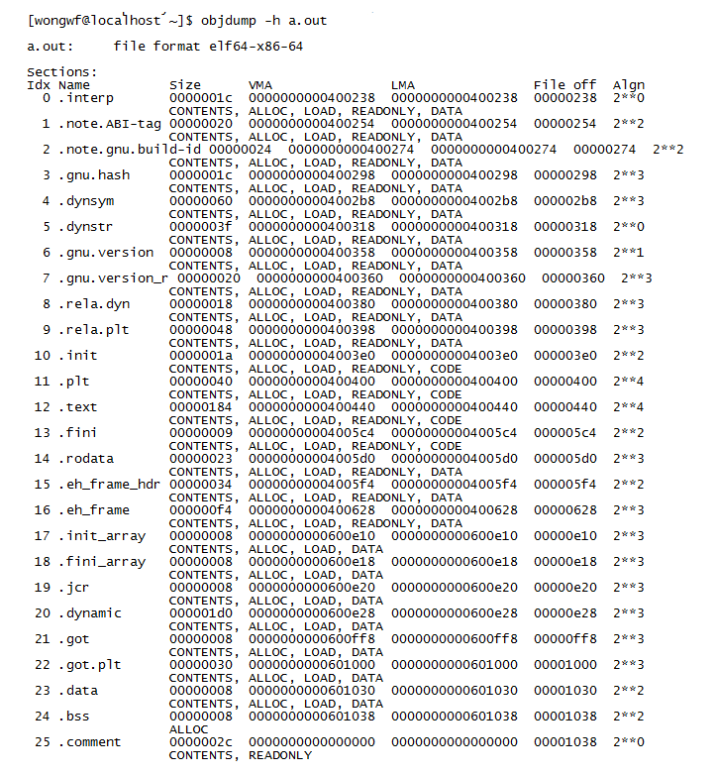
Section Header

Slide 62
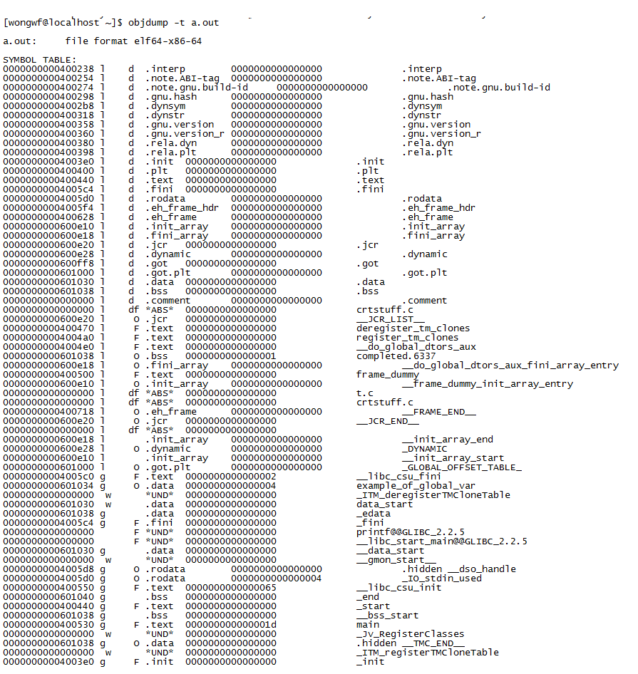
Symbol Table

Slide 63
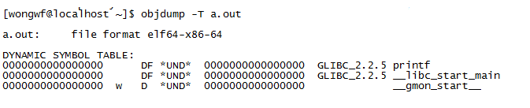
Dynamic Symbol Table

Slide 64
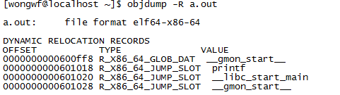
Dynamic Relocation Table

Slide 65
Allocation in Linking

Slide 66
Need for allocation
Each object file compiled differently with no idea about the others
All objects in a given object file assumed to start at address 0
Need to combine into a single executable

Slide 67
Combining ELF object files
Text
Segment
.text
.init
Multiple segments needs to be combined
Linker will collect the sections and place them into the segments of the final executable image plus write the program header
.fini
.data
.data1
Data
Segment
.text
.init
.data
bss
Segment
.fini
.bss
.text
.data
.data1
.bss

Slide 68
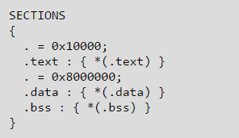
You can control it!
Linkers can be controlled via link scripts
In GNU ld linker, you can use the “-T” option
“Start .text at virtual address 0x10000”
“Start .data followed by .bss at virtual address 0x8000000”
A very simple example

Slide 69
Dynamic Linking

Slide 70
Motivation
Shared libraries: only one copy of commonly used routines for all code in a system
Easy to maintain
Save space
External symbols referenced in user code and defined in a shared library are resolved by the loader at load time.

Slide 71
Advantages
Faster load time: shared library code may already be in memory
Better run-time performance: less likely to page out frequently used code
Easier for shared libraries to be updated

Slide 72
Disadvantages
Need “glue code”
Reduced locality of references
May impact paging
Changes in libraries may break some applications

Slide 73
The Linux Library Hierarchy
Static
(lib*.a)
Linux libraries
Dynamic linking
Shared
(lib*.so)
Dynamic loading

Slide 74
Static Libraries
Simply a concatenation of object files with simple headers
In Linux, it is created using the “ar” utility and has the file extension of “.a”

Slide 75
Linux static library format
ARMAG
SARMAG
/* Archive files start with the ARMAG identifying string. Then follows a
`struct ar_hdr', and as many bytes of member file data as its `ar_size'
member indicates, for each member file. */
#define ARMAG "!<arch>\n" /* String that begins an archive file. */
#define SARMAG 8 /* Size of that string. */
#define ARFMAG "`\n" /* String in ar_fmag at end of each header. */
struct ar_hdr
{
char ar_name[16]; /* Member file name, sometimes / terminated. */
char ar_date[12]; /* File date, decimal seconds since Epoch. */
char ar_uid[6], ar_gid[6]; /* User and group IDs, in ASCII decimal. */
char ar_mode[8]; /* File mode, in ASCII octal. */
char ar_size[10]; /* File size, in ASCII decimal. */
char ar_fmag[2]; /* Always contains ARFMAG. */
};
ARFMAG
ar_hdr - 1
Object file - 1
ar_hdr - 2
Object file - 2
.
.
.

Slide 76
Basically…
If libx.a consists of obj1.o, obj2.o, …, objk.o concatenated
Then
gcc … libx.a
Is just
gcc … obj1.o obj2.o … objk.o

Slide 77
Dynamic linking: issues to resolve
Allocate and load the segments found in the shared libraries
Perform relocation
Recall: relocations are entries in binaries that are left to be filled in later
Two solutions:
Load-time relocation
Position-independence code (PIC)

Slide 78
Key Data Structures
Procedure Linkage Table (PLT)
One entry for each external function reference.
All calls to the corresponding external function routed through this entry.
Easier to patch with actual address
Global Offset Table (GOT)
All external global addresses.

Slide 79
The special three entries of the GOT
GOT[0]: address of the program’s .dynamic segment
GOT[1]: pointer to a linked list of nodes corresponding to the symbol tables for each shared library linked with the program
GOT[2]: address of the symbol resolution function within the dynamic linker
/lib{64}/ld-linux{-x86-64}.so

Slide 80
How it works (preparation - 1)
Compiler ensures every call to the same dynamically linked routine will go to the same PLT entry
PLT[0] is reserved
Each (64) bit PLT entry consists of:
jmpq *GOT[entry corresponding to the function]
Called a “trampoline”.
pushq <GOT entry number of corresponding function>
Starts from 0, i.e. GOT[3].
jmp PLT[0]
GOT[entry corresponding to the function] = address of “pushq” initially

Slide 81
How it works (preparation - 2)
.rela.plt section of executable containing the GOT has the relocation information to fix up the GOT at runtime
Address of .rela.plt itself is found as an entry in .dynamic
Two ways to do dynamic linking:
“BIND NOW”
Lazy binding

Slide 82
“BIND NOW”
Find and load in all dynamic libraries
Go through the main application’s GOT relocation entries and fix all entries
After fixing up, GOT[entry corresponding to the function] = address of actual function in the process image
Therefore, trampoline jump jmpq *GOT[entry corresponding to the function] will jump directly to the function
pushq and the second jmp never used

Slide 83
“BIND NOW”
jumpq *(GOT[…])
❷
Actual calls made
by application
call printf
call printf
uses
❸
jumps to
❶
GOT entry for printf
Fixed up during load time
Where printf was finally loaded.

Slide 84
Lazy Binding
“BIND NOW” can slow down program start up
Define the environment variable LD_BIND_NOW
Many functions may not be used in a single execution anyway
Solution: resolve binding only when we need it
The reserved PLT[0] entry:
pushq GOT[1]
jmpq *(GOT[2])

Slide 85
GOT[2]
Usually it is _dl_runtime_resolve()
In turn will call _dl_fixup()
If profiling enabled, then _dl_runtime_profile()
Assembly code in glibc/dl-trampoline.S

Slide 86
Being lazy - 1
Recall GOT[entry corresponding to the function] = address of “pushq” initially
Lazy = not immediately change GOT entry at load time
First time the PLT function entry is called, it will do jumpq *(…) – jumps right back to the second instruction of the PLT entry, i.e. do:
pushq <GOT entry number of corresponding function>
jmp PLT[0]

Slide 87
Being lazy - 2
PLT[0] will jmp to _dl_runtime_resolve() of /lib{64}/ld-linux{-x86-64}.so
_dl_runtime_resolve() will find final call site and using the relocation information patch the GOT entry
Jumps back to PLT entry of the procedure. This time and all subsequent time, jumpq *(…) will jump using the patched GOT entry

Slide 88
Being Lazy - 3
pushq GOT[1]
PLT[0]
❸
jumpq *(GOT[2])
❷
❶
jumpq *(GOT[…])
First call made
by application
pushq …
jump PLT[0]
uses
❹
call printf
GOT entry
_dl_runtime_resolve()
Where printf was finally loaded.

Slide 89
Being Lazy - 4
pushq GOT[1]
PLT[0]
jumpq *(GOT[2])
❼
jumpq *(GOT[…])
pushq …
jump PLT[0]
❻
Jumps back
uses
❽
call printf
❺
GOT entry
Fixes GOT entry
using relocation
info
_dl_runtime_resolve()
Where printf was finally loaded.

Slide 90
What about the shared objects themselves?
Suppose a shared library itself uses a function in another?
Shared libraries are also ELF
They have their own PLT, GOT and relocation information embedded in the dynamic segment
These too has to be resolved at runtime

Slide 91
Position Independent Code
Problem: hard to fix system-wide where a shared object should reside
Any one can create shared library.
Address Space Randomization (ASR)
64-bit Linux solution: shared objects must be compiled with “-fPIC”
PIC will work anywhere it is placed
All branching uses relative addressing
Local data no issue (relative to stack or base pointer)
Global data: use indirect loading via GOT
Global shared procedure: use PLT and GOT

Slide 92
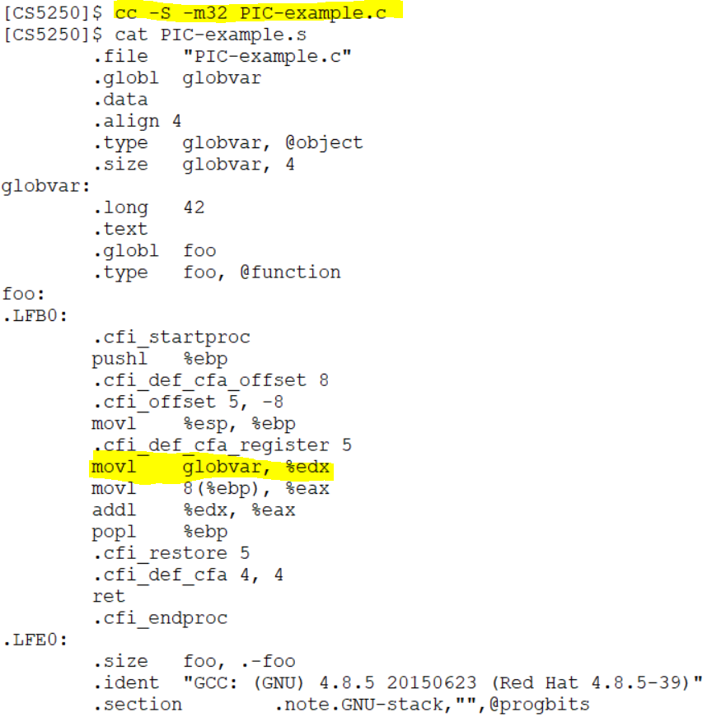
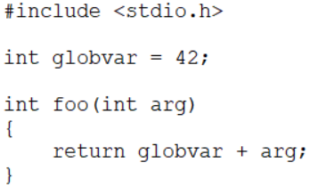
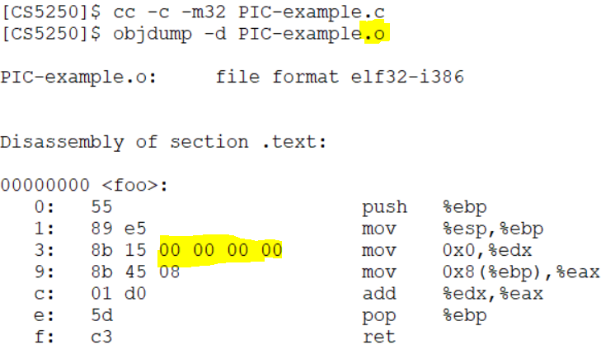
(Just for fun) PIC example in 32 bit x86
C source
Linker/Loader to fill this in

Slide 93
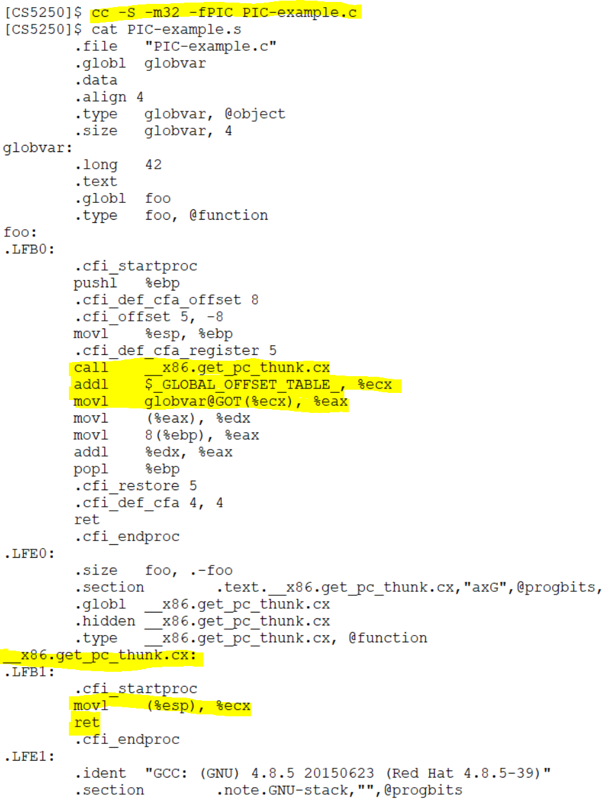
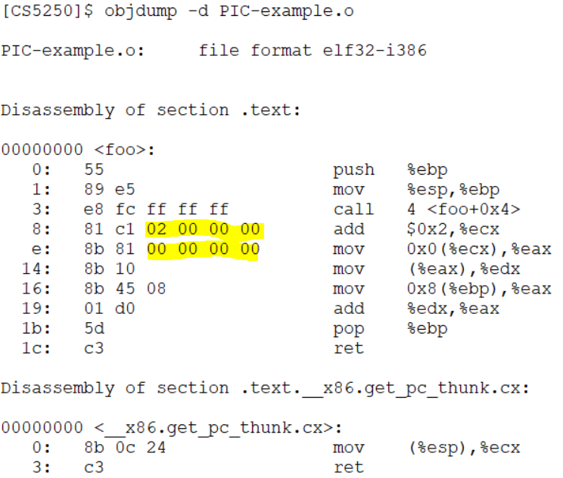
(Just for fun) PIC example in 32 bit x86
%ecx contains EIP after call
Use GOT to indirectly obtain variable’s address
Linker/loader to fill these in
Move return address to %ecx

Slide 94
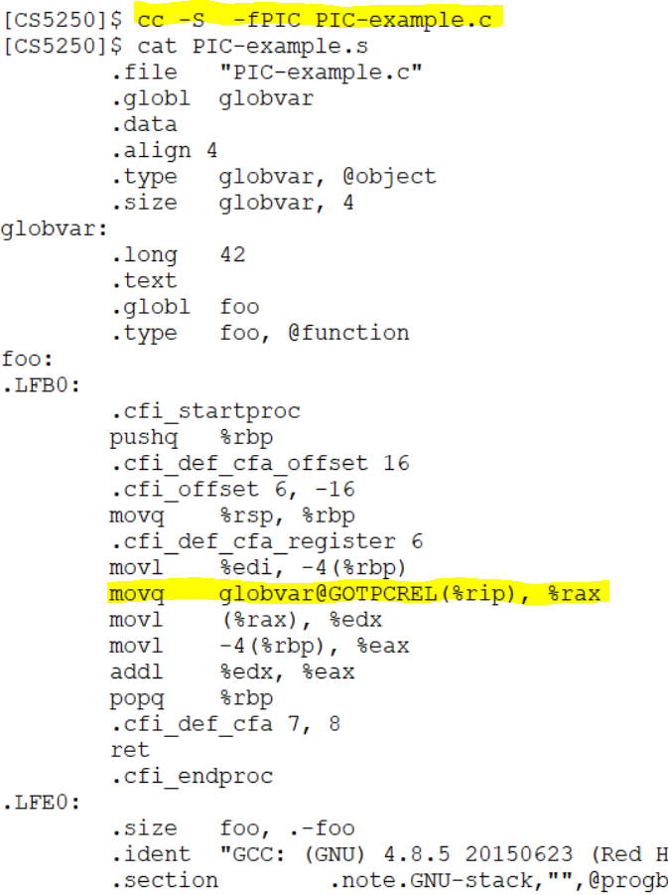
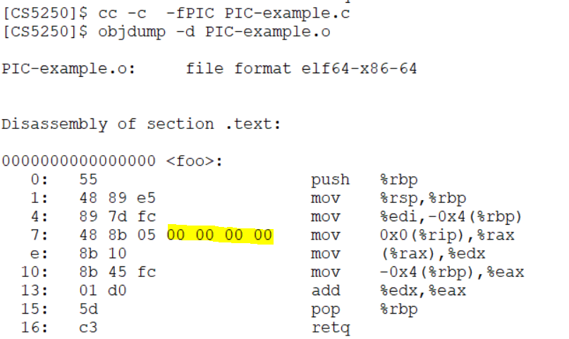
(Just for fun) PIC made easier in x86-64
New addressing mode in x86-64
Linker/Loader to fill this in

Slide 95
Dynamic Loading

Slide 96
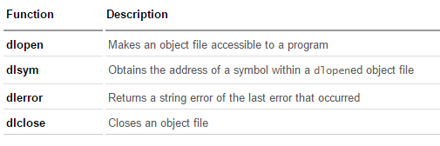
Dynamic Loading API
Loading a shared library under the control of the application
Linux DL API
Must link with “-ldl” option

Slide 97
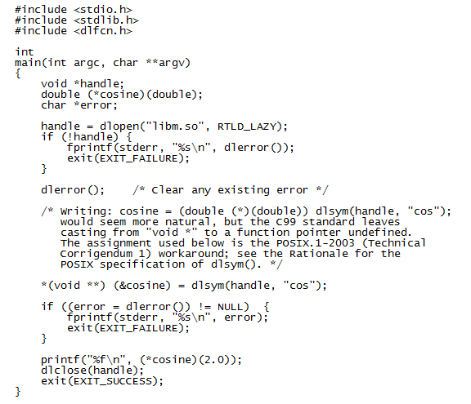
An example
Compile with:

Slide 98
End

